Slide 1

SHREE RAMSWAROOP MEMORIAL UNIVERSITY
Assignment:-13
Java Enterprise Edition Lab - 13
Submitted to:
Submitted by:
Vidushi Srivastava
Mukesh Prajapati
Btech (Cse Industry integrated)
Roll No – 202410101230007

Slide 2
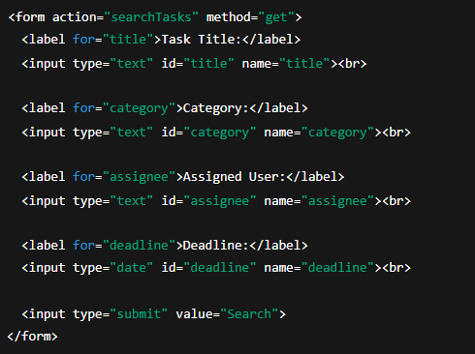
1. Search Form (JSP):

Slide 3
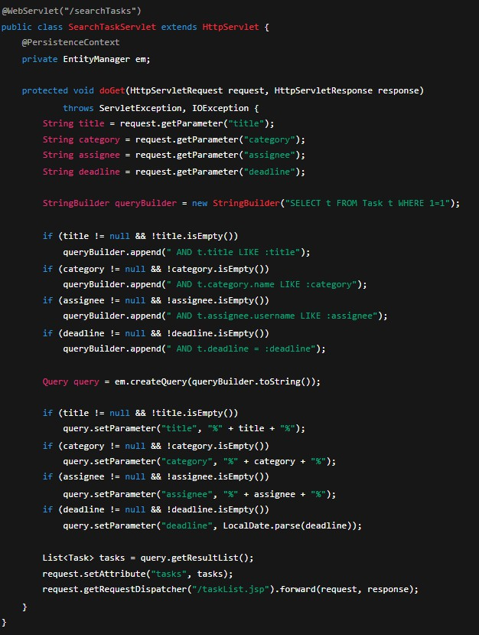
2. Servlet Implementation (SearchTaskServlet.java):

Slide 4
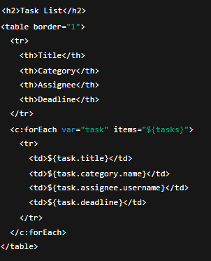
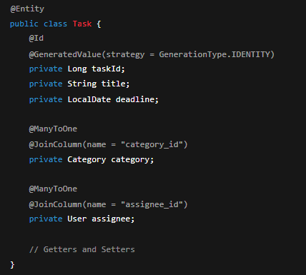
3. Task Display Page (taskList.jsp):
4. JPA Entity Setup (Task.java):

Slide 5
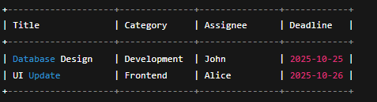
Output Example (Representation):

